Slide 1


ZOMATO RESTAURANTS
ANALYSIS
NIKHIL PATIL

Slide 2


Slide 3
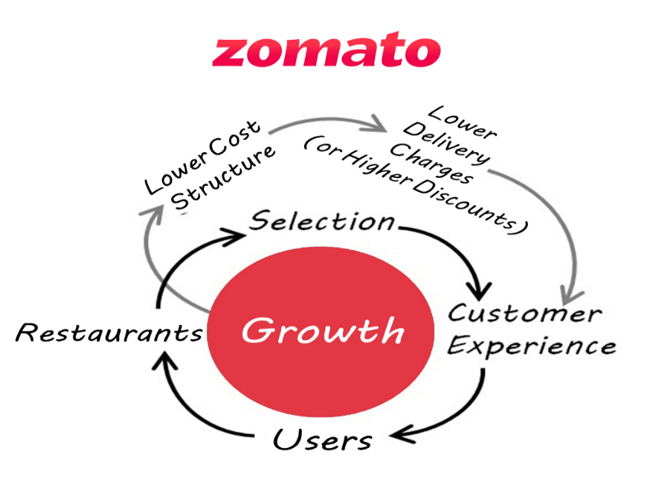
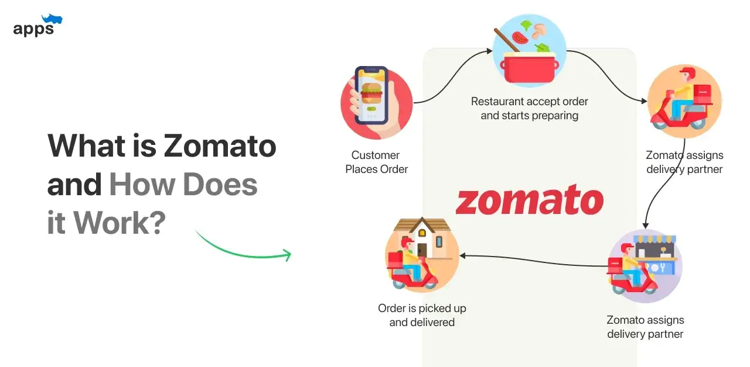
INTRODUCTION
Zomato is a global food delivery and restaurant aggregator platform founded in 2008, headquartered in Gurugram, India. It provides users with restaurant information, reviews, and food delivery services across numerous countries. Zomato's user-friendly interface and efficient delivery network have contributed to its widespread popularity. Additionally, the platform offers restaurant management software to help eateries streamline operations, manage orders, and engage with customers. Through continuous innovation and expansion, Zomato has become a leading player in the food technology industry, connecting millions of users with a diverse range of dining options worldwide.

Slide 4
Objectives
The team is looking for expansion and opening new restaurants.
Helping people discover great places around them
Building amazing experiences around dining
Understanding market trends.

Slide 5
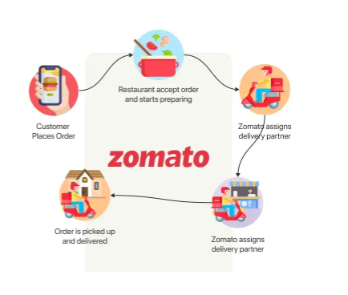
How Zomato works

Slide 6
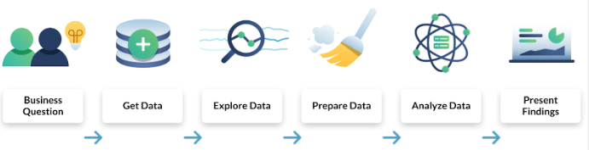
ANALYTICAL APPROACH & TOOLS
Data Cleaning: Utilized functions like TRIM, CLEAN, and Remove Duplicates to ensure data accuracy.
Data Enrichment: Enhanced the dataset with additional variables using VLOOKUP to cross- reference external data sources.
Descriptive Analysis: Employed Pivot Tables for summarizing key metrics and identifying sales patterns across different regions and product categories.
Trend Analysis: Conducted time series analysis using TREND and FORECAST functions to predict future sales growth.
Customer Segmentation: Applied SORT and FILTER functions to classify customers based on purchasing behavior and demographics.
Visualization: Created dynamic charts and dashboards for data representation, enabling Interactive data exploration.

Slide 7
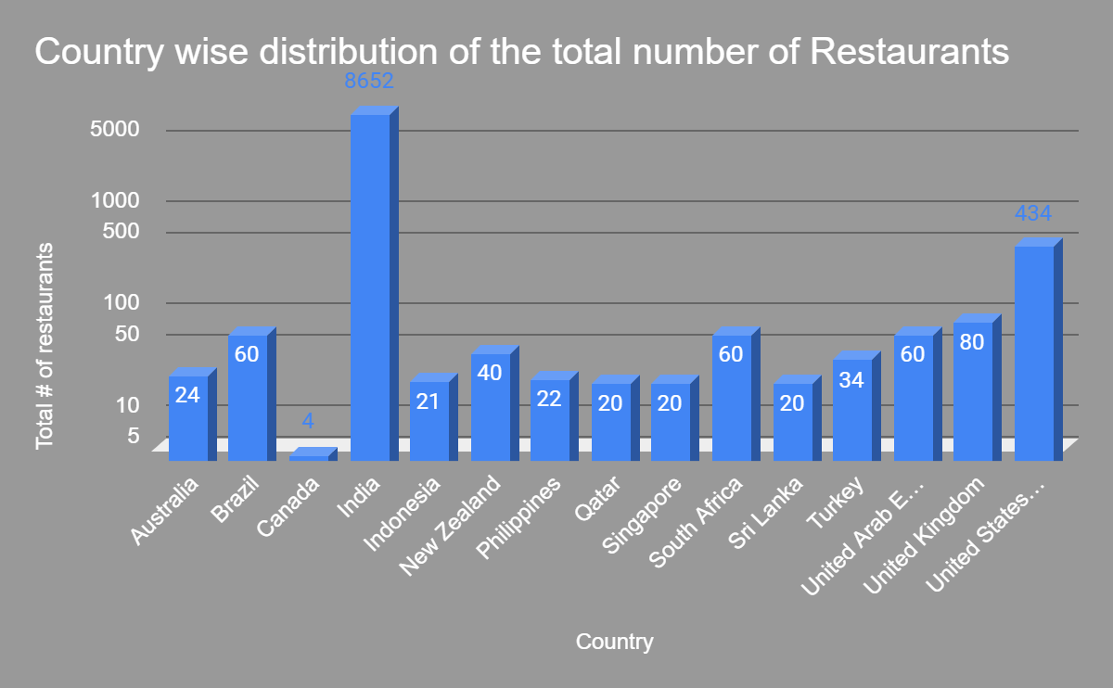
Analysis
India represents the most dominant market of Zomato affiliated restaurants with a market share close to 93%

Slide 8
Growth in Market
Almost more than a 1000 restaurants are opened each year across different markets

Slide 9
Customer view
Indonesian restaurants, on an average, receive highest number of average votes

Slide 10
Cusines Expenditure country
Herer we can se the country like Indonesia, New Zealand , Phillippines and Qatar has got ratings and has price range in
Affordable range

Slide 11
Country selection for opening new restaurant
Here are the few country where we can open new restaurants.
Here we consider the ratings and votes given by the customer in every restaurant as the ratings
are low and votes are more then there is chance we can open new restaurant as may customer ` be not liking the food that much so we can come with Good cuisines and grow our market

Slide 12
Recommendations for opening new restaurants
Australia Montville
167 Main St, Montville, QLD
Phillip Island,
4/17 The Esplanade, Cowes, VIC
Canada Chatham-Kent
150 Richmond St, Chatham-Kent, ON N7M2V2
Qatar Doha
Beside Le Mirage Suites, Fereej Abdul Aziz Street, Al Doha Al Jadeeda, Doha
Indonesia Jakarta
Jl. Tanjung Duren Utara III, Blok M Kav. 32, Tanjung Duren, Jakarta
BogorJl.
Kantor Pos No. 6, Bogor Timur, Bogor

Slide 13
Approach used
Target those area where no. of restaurant is less :
Analyze areas with a low density of existing restaurants but high overall ratings. This suggests a market with
customer demanding areas .
Target Price Range of the Restaurants :
Analyze the price range most frequented by audience. Align your restaurant's concept and
pricing strategy with their budget preferences to maximize appeal
Price Range Correlation with Cuisine:
Identify any correlations between price range and cuisine
Exploring Existing High-Rated Restaurants :
Identifying the high rated restaurant for knowing which cuisine make audience attract.
Prioritize Budget-Friendly Options in Cost-Conscious Areas:
Analyze data to identify areas with a lower average cost for two

Slide 14
.
I will first go with research on global or regional food trends, consumer preferences, and dining habits.
I also consider the geographical location as the different country has different Population, currency, Income level , Age diversity in various country and cities .
Considering economic indicators such as GDP per capita, unemployment rates, and consumer spending patterns. Strong economies with growing middle-class populations generally offer better prospects for restaurant businesses.
We will consider quality ingredients, transportation networks, and availability of skilled labor. A robust infrastructure can streamline operations and minimize costs.
Identify markets with potential for future growth and expansion opportunities. This could involve analyzing population growth projections, urban development plans, and emerging tourism trends.
We will also consider risk management as like geopolitical instability, currency fluctuations, and natural disasters. Mitigation strategies should be developed to address these risks.

Slide 15
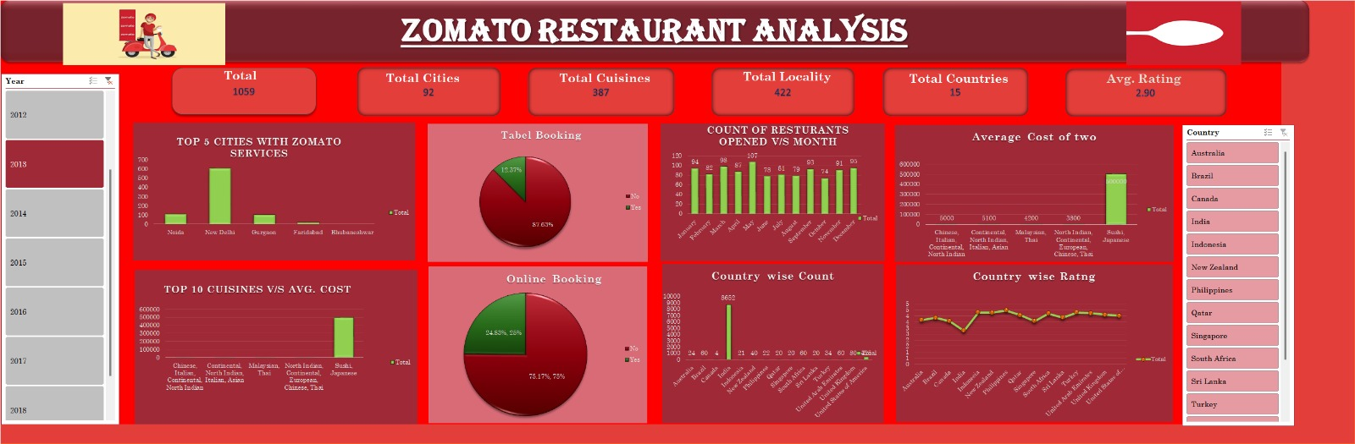
Dashboard and Visualizations :

Slide 16
Conclusion
Zomato should capitalize on its multi-cuisine approach to cater to diverse tastes, enhancing its appeal to a broader customer base.
Canada, Australia ,Qatar and the Indonesia are some of the most unclustered markets for zomato that may offer new opportunities for market penetration.
Customers are also ready to spend more money according to there need.
Online delivery and table booking generally exceed into a higher rating.
This approach to cuisine selection ensures that investments are tailored to the financial capacities and strategic goals of the stakeholders, maximizing the potential for success in the chosen markets.

Slide 17
References
https://en.wikipedia.org/wiki/Zomato
https://www.google.com/

Slide 18
Thankyou

